Slide 1
Tutorial:
Components and Composition
Building a Software System from Reusable Blocks
Advanced Software Engineering 475
Andrew McVeigh

Slide 2
Quick Guide to Evolve
Download and unzip Evolve:
  www.doc.ic.ac.uk/~amcveigh/evolve-tutorial2.zip
  Install Java1.6, and double click on evolve.jar or evolve.exe
Open the example in the distribution
  Use the menu ”File/Open/Existing Model” and choose GUITutorial/ase475-gui-tutorial.evolve
Some keys and tips:
  Double click on a stratum to view it
  Double click on the diagram to go ”up” again
  Undo is ctrl-Z, redo is ctrl-Y
  Create something by clicking on an icon and then on the canvas. For connectors, click on the start element, hold down and release over the end element
  Delete the element using shift backspace, delete just the view using backspace

Slide 3
The Problem...
We have some common components
  And fred, lily and bob all want to reuse them
Fred: wants next of kin fields
Lily: wants town field
Bob: wants things to stay same
Name and address
widgets from the lectures

Slide 4
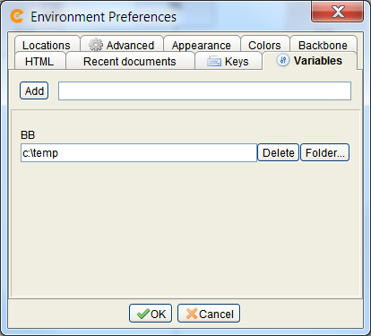
Running the Examples
Set variables
  Press F4 or menu ”File/Preferences/Edit envionment prefs”
  Choose ”Variables” tab
  Add BB variable and set it to a temporary folder (i.e. c:\temp)
Run each variant
  Select a package:
  E.g. fred
  Press ctrl-T to ”tag” it
  Press ctrl-R to ”run” it
  You should see a swing
  window appear

Slide 5
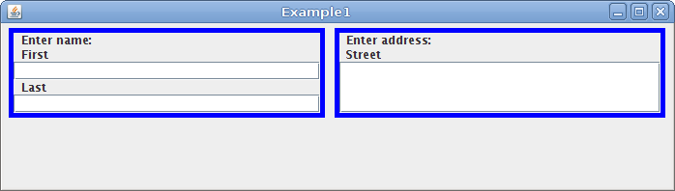
The Problem...
We have a common set of name and address widgets
  Fred wants to add ”next of kin” entry fields
  Lily wants to add a ”Town” field to address
  Bob wants it to stay as it was... (He's very conservative)

Slide 6
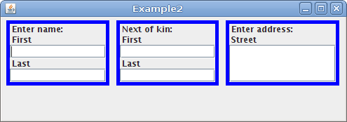
Exercise #Fred: Adding Next of Kin
How can we add the extra widget?
  How can we parametrise to allow the widget to show either ”Next of kin:” or ”Enter name:”?
  How can we get it to appear in the middle?

Slide 7
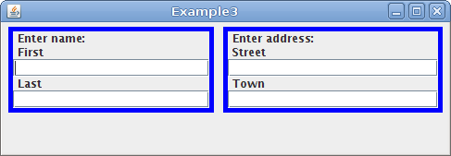
Exercise #Lily: Adding a Town field
How can we add this such that Bob and Fred don't see it?

Slide 8
Exercise #Bob: Still the same...
After the changes, we must verify that Bob's system hasn't changed...
  i.e. Doesn't want next of kin or town fields

Slide 9
Exercise #Bob2: He changes his mind...
Bob decides to upgrade and suddenly wants to see both the next of kin *and* town fields
Questions:
  Why did each party require their own GUI composite?
  What would we have done if we couldn't modify AddressWidget?
  Could we avoid parametrisation of NameWidget or making a new name or address widget?
  (the problem is that the 2 changes push work onto Kim, who owns the common base)
  Can we avoid so much manual copying of component structure?
Prizes:
  A halloween sweet (i've still got another leftover jar!) for each exercise, and a handful of sweets for achieving exercise Bob2 and attempting the questions.

